Slide 1

Solicitors & Attorney
8 St. James Square London SW1Y 4JU
T: 020 7243 6122

Slide 2

WHEN IS CONTENT RELEVANT?
Content can be relevant at each stage
The First and Second Limb can be content sensitive
Bad Faith definitely includes consideration of the content at the site in question.
National law can be relevant to that content
In many cases the content of the website in question will remove
any doubt or compound it. it.
2
Notes:
2

Slide 3
HOW RELEVANT IS CONTENT?
Hypothesis
Content is very often determinative:
True or False?
3
Notes:
3

Slide 4

FIRST FACTOR
WIPO Overview:
  First factor: “1.15 Is the content of the website associated with a domain name relevant in determining identity or confusing similarity? The content of the website associated with the domain name is usually disregarded by panels when assessing confusing similarity under the first element. In some instances, panels have however taken note of the content of the website associated with a domain name to confirm confusing similarity whereby it appears prima facie that the respondent seeks to target a trademark through the disputed domain name. Such content will often also bear on assessment of the second and third elements, namely whether there may be legitimate co-existence or fair use, or an intent to create user confusion.” el
  e
  First factor factors: misspelling, inclusion, targeting etc prima facie that the respondent seeks to target a trademark through the disputed domain name.
4
Notes:
4

Slide 5
SECOND FACTOR
Second factor legitimate use includes fan/sucks, speech and criticism, nominative use and resales, illegal activity. Content is squarely relevant.
  E.g. “2.13 How do panels treat complainant claims of illegal (e.g., counterfeit) activity in relation to potential respondent rights or legitimate interests? 2.13.1 Panels have categorically held that the use of a domain name for illegal activity (e.g., the sale of counterfeit goods or illegal pharmaceuticals, phishing, distributing malware, unauthorized account access/hacking, impersonation/passing off, or other types of fraud) can never confer rights or legitimate interests on a respondent. Particularly in the case of counterfeits and pharmaceuticals, this is true irrespective of any disclosure on the related website that such infringing goods are “replicas” or “reproductions” or indeed the use of such term in the domain name itself. [See sections 3.1.4 and 4.2.]. 2.13.2 Panels are generally not prepared however to accept merely conclusory or wholly unsupported allegations of illegal activity, including counterfeiting, even when the respondent is in default…. that the images of the goods prima facie suggest (e.g., where the relevant logo is distorted) that they are not genuine, that the respondent has misappropriated copyrighted images from the complainant’s website.
5
Notes:
5

Slide 6
COPIES
“No rights and legitimate interests may be found when a respondent sells counterfeit versions of a complainant’s products in competition with a complainant’s business. See, e.g., Keihin Corp. v. Youli Ltd., FA 1106190 (Forum Dec. 18, 2007). Hence, the Panel finds that the sale of counterfeit products is evidence that Respondent does not make a bona fide offering of goods or services or a legitimate noncommercial or fair use of a disputed domain name pursuant to Policy ¶ 4 (c)(i) or ¶ 4(c)(iii). See, e.g., eLuxury.com Inc. v. WangJunJie, FA 1075554 (Forum Nov. 30, 2007).” “Respondent uses the disputed domain names illegally ..by facilitating Internet piracy and enabling users to avoid purchasing Complainant’s products… constitutes disruption to a [c]omplainant’s business which demonstrates bad faith registration and use under Policy ¶ 4(b)(iii).” Guess? IP Holding L.P. and Guess?, Inc. v. Linan / linanbangongshi and hu sugor / sugorguoguo, FA1410001587466 (Forum Dec. 13, 2014); see also Cameron Thomaz P/K/A Wiz Khalifa and Wize Khalifa Trademark, LLC. v. Kyle Lynch, D32014-1525 (WIPO Nov. 4, 2014) (finding bad faith registration and use where respondent’s webpages offered illegal downloads of complainant’s music). Furthermore, the selling of counterfeit products creates the likelihood of confusion as to the complainant’s affiliation with the disputed domain name and allows the respondent to profit from that confusion under Policy ¶ 4(b)(iv). ” “Panels have found bad faith where “[t]he Complainant alleges that the Respondent is using [the] Domain Name for software piracy.” gamigo AG v. Wang Meng, D2011-1659 (WIPO Mar. 17, 2013). Similarly, “the use originally made of the disputed domain name to offer the unauthorized download and installation of the Complainant's . . . software products obviously amounts to a use of the disputed domain name in bad faith.” Autodesk, Inc. v. Milo Kram, D2016-1779 (WIPO Nov. 9, 2016). Therefore, the Panel finds bad faith registration in light of the fact that the Respondent is using the domain names in dispute to sell illegal or counterfeit copies of Complainant’s products. See, e.g., Investors Business Daily Inc., Data Analysis Inc. v. Billy Campbell/Registration Private, Domains by Proxy LLC, D2014-2049 (WIPO Jan. 23, 2015).”
Nintendo of America Inc. v. zhiqing yu / savane thaline / elic / xiongjie wu, The Forum: FA170900174876
Notes:
6
6

Slide 7
CASES
Fake updates -- BMW Nav Update
Bayerische Motoren Werke AG v. Osama Javed, WIPO D2019-1625
Counterfeit T-shirts with Harley-Davidson Logo marks
H-D U.S.A., LLC v. Malinda Dowling, The Forum FA1608001691466
Counterfeit handbags, shoes and other fashion items of Dolce & Gabbana Srl.
Dolce & Gabbana S.r.l. v. Qing Liao, WIPO D2013-1761
Counterfeit clothing (but failed on limb one)
Zimmermann Wear Pty Ltd v. Sam Dumond, The Forum FA 1808001802176
News items/articles were copied
Around The Rings Inc. v. Dunsar Media Company Limited, Case No. D2010-0153
Notes:
7
7

Slide 8

How does copyright figure?
Logo Marks
Illegal use
Piracy
Phishing
8
Notes:
8
8
8

Slide 9

THIRD FACTOR
Third factor
  “3.2 What circumstances further inform panel consideration of registration in bad faith? In addition to the above-described application of the specific Policy criteria, panels have applied a range of considerations in assessing bad faith…. include: (i) the nature of the domain name (e.g., a typo of a widely-known mark, or a domain name incorporating the complainant’s mark plus an additional term such as a descriptive or geographic term, or one that corresponds to the complainant’s area of activity or natural zone of expansion), (ii) the chosen top-level domain (e.g., particularly where corresponding to the complainant’s area of business activity or natural zone of expansion), (iii) the content of any website to which the domain name directs, including any changes in such content and the timing thereof”.
9
Notes:
9

Slide 10
CAC GUIDANCE
CAC HANDBOOK 2nd Ed.
P.9 Q1. To what extent is national law relevant to legitimate rights or interests and bad faith? The role of national law is fairly limited in determining whether a respondent has a legitimate right or interest in a domain name. Those limitations likewise affect determinations of whether a respondent has registered or used a domain name in bad faith. Consensus View: National law is relevant…
P.40 re factor 1 “2. Can the content of a website be relevant in determining whether a domain name is identical or confusingly similar? View: Other panel decisions include also the content of the website and the goods for which the right is used to identify a confusing similarity.”
p.44 re factor 2, “3. Can a reseller of trademarked goods or services have rights or legitimate interests in a domain name which contains such trademark? There is only one decision discussing the issue, therefore it is preliminary to consider it a consensus view. The panel adopted a view a reseller or distributor can make a “bona fide” offering of goods and services to have rights or legitimate interests
10
Notes:
10

Slide 11
CAC GUIDANCE
CAC HANDBOOK v2
P. 46 “6. To what extent is the national/community law relevant to a panel assessment of rights and legitimate interests and/or bad faith? Par. B 3 (b) (8) of the ADR rules provides that the panel can admit or ask for, in its sole discretion, further statements or documents from either of the parties in addition to the complaint and the response. The panels do not seem to apply national law except for assessment if there is a right to a name to which the domain name is identical or confusingly similar (which must be recognized or established by national and/or Community law). Nonetheless national law can be considered if the parties have the same nationality or location and if it seems appropriate. ”
P.56 “7. Is there a need to show bad faith if there is no legitimate interest? If there is no legitimate interest, there is no need for the complainant to prove bad faith. Thus frequently the Panel decides to address both the legitimate interest and the bad faith, especially when the respondent failed to submit a response.”
P.57” 8. Are there other indications of bad faith besides those listed in Art. 21 (3) of the PPR? Consensus view: The list contained in Article 21 (3) of the PPR is not exhaustive”
11
Notes:
11

Slide 12
Sucks Facts
ICANN approved the .sucks gTLD in 2015.
In trade mark law, this type of use is “Nominative”. The Complainant’s name is being used to say something (critical) about the Complainant. This is protected in various ways in EU trade mark law. It is not regarded as trade mark use and would not sustain an infringement claim as this nominative use does not impact the “badge of origin function” of the mark.
US trade mark law will also protect such use as fair use, and this covers news and criticism. At the intersection between speech and trade marks, under the First Amendment, speech usually always wins.

Slide 13
NOMINATIVE FAIR USE
In nominative fair use cases, the mark is used to refer to or describe the plaintiff’s own goods or services.
The Ninth Circuit named this nominative fair use in New Kids on the Block v News Am. Publ’g, Inc. 971F.2d 302 (9th Cir.1992)
It gave the following example:
“[Asto]the trademarked term,‘ChicagoBulls’…one might refer to the ‘two-time world champions’ or ‘the professional basketball team from Chicago,’ but it’s far simpler (and more likely to be understood) to refer to the Chicago Bulls.” Such a use of the trade mark would “not imply sponsorship or endorsement of the product because the mark is used only to describe the thing, rather than to identify its source”.
13
Notes:
13

Slide 14
NOMINATIVE FAIR USE
In Playboy Enterprises v Welles it was suggested that likelihood of confusion should be replaced with these three factors from New Kids on the Block, whether:
The product is “readily identifiable” without use of the mark;
The defendant has used more of the mark than “necessary”; and
The defendant falsely suggested he was sponsored or endorsed by the trademark owner
Playboy Enterprises Inc v Welles 279 F.3d 796,801 (9th Cir.2002).
14
Notes:
14

Slide 15
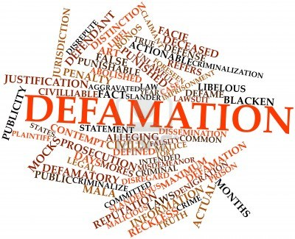
Defamation Overview

Slide 16
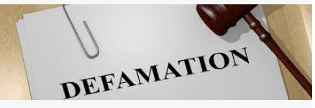
How does defamation figure?
    Legitimate Fair Use
    -Speech cases
    -Sucks cases
    -Criticism sites
    Nominative use v
    Tarnishment, dilution,disparagement
16
Notes:
16
16
16

Slide 17
Criticism v Tarnishment
    Criticism is not the equivalent of tarnishment, and the fact that a site primarily hosts criticism does not mean that Respondent’s intent was to tarnish Complainant’s mark.
    McLane, WIPO No. D2000-1455.
    Panels have distinguished criticism and tarnishment, explaining that otherwise “every website critical of a brand owner could be deemed a tarnishing use. Rather, [t]arnishment in this context refers to such unseemly conduct as linking unrelated pornographic, violent or drug-related images or information to an otherwise wholesome mark.”
    Ryanair, No. D2006-1194; see also Alsace, No. D2013-2025. Criticism is not “bad faith simply because the criticism might have an adverse impact on the Complainant’s business.” MUFG Union Bank, Case No. DME2014-0008.
17
Notes:
17
17
17

Slide 18

A UDRP proceeding is not the proper forum for addressing claims of defamation.
The United Grand Lodge of Queensland v. Redacted for Privacy, 1&1 Internet Inc. / Alfred Warburton, Case No. D2018-2862 (WIPO Mar. 14, 2019),
Wyles v. FlokiNET Ltd WhoisProtection, FlokiNET Ltd, Case No. 2020-0947 (WIPO Jun. 8, 2020);
MUFG Union Bank, N.A. v. Bookout, Case No. DME2014-0008 (WIPO Dec. 3, 2014)

Slide 19



PRECEDENT
Website was a "complaint" site where the use of the trademarks was nominative. Respondent contends he was protected by the guarantee of free speech under the First Amendment of the U.S. Constitution and was exempted from liability by the "fair use" exemption under the U.S. Federal Anti-Dilution Act of 1996 for use of a famous mark if the use is for non-commercial purposes or for news reporting and commentary. Respondent further asserts that no prudent Internet user would be confused as to the source or sponsorship due to the home page stating that "This website is not affiliated in any way with Bridgestone/Firestone, Inc." and pages whose content is sharply critical of the Complainants. Complaint failed.
  Held, questions regarding whether criticism on a respondent’s website is accurate or defamatory are generally considered to fall outside of the scope of the Policy, as they may involve determinations on truth or falsity that cannot be determined in the limited scope of a UDRP proceeding
Bridgestone Firestone, Inc., Bridgestone/Firestone Research, Inc., and Bridgestone Corporation v. Jack Myers, WIPO Case No. D2000-0190.
19
Notes:
19
19
19

Slide 20
PRECEDENT
UDRP panels long have recognized that an authentic criticism site may give rise to rights or legitimate interests under the Policy. It was an obvious criticism site, and the Panel finds that the site was not likely to confuse consumers.”) Even if the website at issue contains content that is alleged to be libelous, defamatory, or otherwise highly inappropriate (as Complainant alleges here). Complaint failed.
It is not the province of UDRP panels to pass judgment on such allegations; rather, claims of libel or defamation should be brought in forums that have jurisdiction over claims of that nature.
Dover Downs Gaming & Entertainment, Inc. v. Domains By Proxy, LLC / Harold Carter Jr, Purlin Pal LLC, WIPO Case No. D2019-0633
20
Notes:
20
20
20

Slide 21
PRECEDENT
The Domain Name was the name and trademark with the addition of the word “investigation” and .com.
The Complainant claimed tarnishment of the Complainant’s trademark. The Policy is limited to finding whether a respondent is exercising their legitimate free speech rights, as part of a noncommercial use of a domain name..” Although, the term “investigation” is not a clear derogatory term, it suggests at a minimum a form of accusation, which could still be justified under the circumstances as outlined above.
The composition of the Domain Name with such term would not create confusion overall, the Panel considers that the Website also does not create a misleading or false impression as to it being an official website of the Complainant or its purpose. ..the Panel concludes that the Website is prima facie non-commercial, genuinely fair, and does not appear to be a pretext for cybersquatting, commercial activity, or tarnishment.
Therefore, the second element of the Policy has not been satisfied and the complaint failed.
Lou Taylor v. Noelle Van Der Valk, WIPO Case No. D2021-2824
21
Notes:
21
21
21

Slide 22
PRECEDENT
Both parties were in local politics.
Respondent registered the domain name of the Complainant with the .com.
The website to which it resolved contained content that was critical of Complainant, his profession, his personal life and his qualifications to run for public office.
Respondent also distributed a flyer in the parties’ community which featured a photograph of Complainant along with the text: “I WANT YOUR VOTE! Learn more about me at [the disputed domain].
Respondent contended that he has rights and a legitimate interest in the website as a criticism site for purely political purposes, and constituted a permissible form of political campaigning against a political opponent only for the noncommercial use of political comment and debate.
Held, Complaint upheld as the use was impersonation. Held Because of the confusion and deception created by Respondent’s use of the Disputed Domain Name, the Panel finds that Respondent does not have rights or legitimate interests.
Victor Bekhet v. Kirk Uhler / Brian Jagger WIPO Case No. D2021-0039Because of the confusion and deception created
22
Notes:
22
22
22

Slide 23
CAC PRECEDENT
Three panel decision. Second limb. Sucks case. Majority and minority dissenting decision.
Re Everything.sucks Inc., which has a platform for end-users to post comments and engage in discussion and criticism on a wide variety of topics (The Platform). The Respondent was related to the Platform and deals with its domains and registered the Disputed Domain Name under the “.sucks” TLD to direct web traffic to the relevant page of the Platform about the Complainant.
Held, Complaint upheld by the Majority mainly use to the fact that Platform was commercial and the domain registered for the purpose of promoting it rather than for expressly a personal opinion. Citing section 2.6.1 of the WIPO Overview whereby “the respondent’s criticism must be genuine and non-commercial” noting that “in a number of UDRP decisions where a respondent argues that its domain name is being used for free speech purposes the panel has found this to be primarily a pretext for cybersquatting, commercial activity, or tarnishment”(see similarly Case No. 103142 ”BIODERMA.SUCKS”).
Dissenting Judgment: “The Complainant opposes the public criticism/ criticism of its business and wants to ideally stop or at least to demote it - to protect its reputation. The Respondent and Everything.sucks Inc run a business that facilitates and enables the expression of others. Taking this conflict, we must consider for example if a company can stop a newspaper or TV station reporting on a company’s business performance by claiming trade mark infringement when its name is used – this is that same scenario. Trade marks cannot and should not be used to supress criticism and discussion. It is not trade mark infringement for a newspaper to publish an item about the Complainant. The Respondent/the Platform are in the same position as a publisher such as a newspaper or magazine which hosts third party comments. The Respondent does have a commercial interest, but it is not its only interest, it is also interested in publishing the speech of others and providing a forum for their exercise of their rights. The fact that there is some commercial motivation is not determinative. ”
Cargotech CAC Case No. 103423ecause of the confusion and deception created
23
Notes:
23
23
23

Slide 24
CAC PRECEDENTS
See Honey Self cases, No. 103142 –also re the Everything Sucks site.
“The Respondent cannot claim to have legitimate interest based on free speech website. He is not the person who is said to be making the allegedly free speech commentary or criticism. The Respondent is a third party, or at least claims to be. Yet the Respondent is the registrant of the disputed domain name, not some other person who may or may not have a genuine gripe to make about the Complainant. In fact, the Respondent has no way of knowing anything of the genuineness of any criticisms made on the associated website. ”
But see:
UPWORK INC. v. Sunny Kumar, CAC 101294, October 30, 2016
NOVARTIS AG v. BRANDIT GmbH, CAC 103013, May 26, 2020
Both decided by the same Panelist these cases apply an “all circumstances” view.
Importantly, in each of these cases, the respondent, in whose favour the panel found, was the person seeking to make genuine criticism or to publish genuinely held views/commentary about the complainant.
24
Notes:
24
24
24

Slide 25
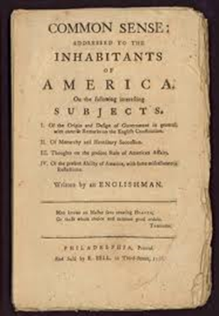

Slide 26
SPEECH
Free speech of English origin but was never part of the law
Role of Jury (and its ability to acquit) thought a better protection for free speech than any constitutional guarantee (Dicey 1885) plus rule against prior restraint on speech
Negative rights culture –could do all that was not prohibited
Then European Convention, Art 10 of ECHR in 1953 but a treaty obligation only
ECHR enforceable domestic law with Human Rights Act 1998 (in force in 2000)
Convention binds the Courts which is how it enters the law—also binds public authorities (includes private ones with a public function)
But Art 10 is balanced against other rights (including now reputation under Art. 8) and does not have US pre-eminence
26
Notes:
26
26
26

Slide 27
SPEECH
Art 10. protects speech which is offensive, shocking or disturbing, see Handyside v United Kingdom (5493/72)at [49] and Sunday Times v UK (No 2) [1992] 14 EHRR 123 (Spycatcher) at [50]:
“Freedom of expression constitutes one of the essential foundations of a democratic society…it is applicable not only to “information” or “ideas” that are favourably received or regarded as inoffensive or as a matter of indifference, but also as to those that offend, shock or disturb …”
Restrictions must be necessary and proportionate and knowable in advance to be convention compliant.
27
Notes:
27
27
27

Slide 28
SPEECH
In Miller v College of Policing, [2020] EWHC 225,Knowles J, emphasised the importance of freedom of expression. The judgment opens with a quote from the unpublished introduction to Animal Farm (1945) by George Orwell:
“If liberty means anything at all, it means the right to tell people what they do not want to hear.”
The judgment goes on to quote the well-known words of Sedley LJ in Redmond-Bate v DPP 1999] Crim LR 998 at [20]:
“Free speech includes not only the inoffensive but the irritating, the contentious, the eccentric, the heretical, the unwelcome and the provocative… Freedom only to speak inoffensively is not worth having.”
28
Notes:
28
28
28

Slide 29
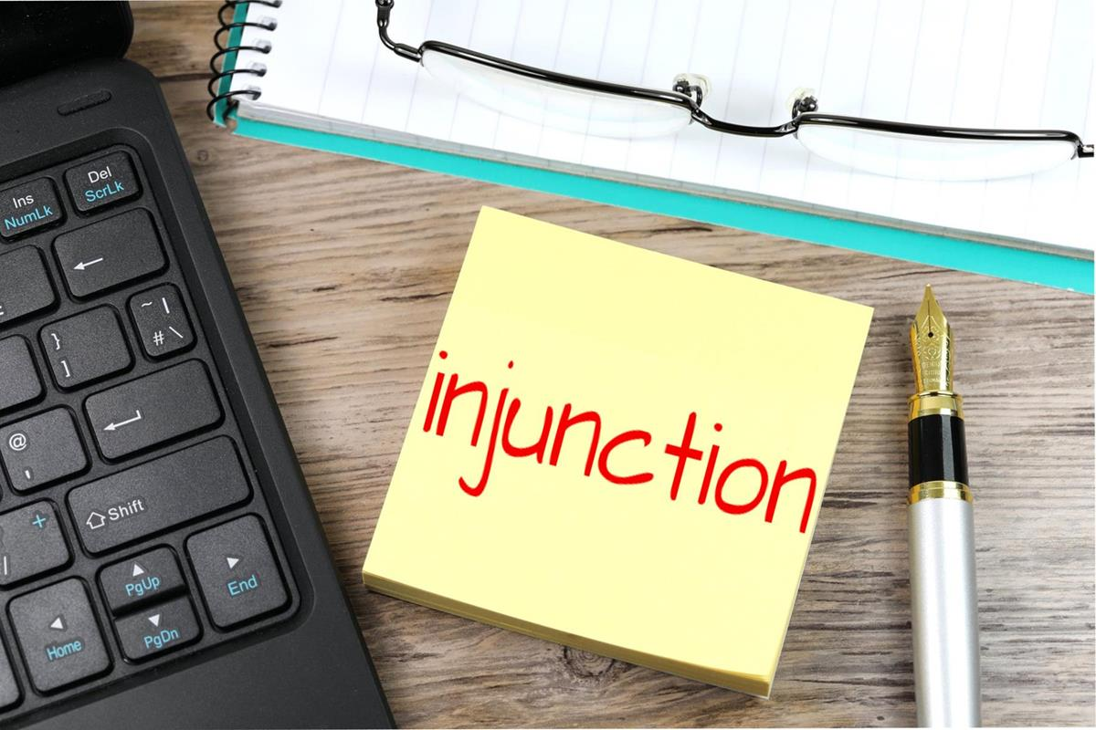
RIGHT TO OFFEND
Hertel v Switzerland, 1999) 28E.H.R.R.534; 5B.H.R.C.260
The claimant, an independent research scientist, conducted a study on the impact of microwaves on food which concluded that they influenced a carcinogenic process. The study was cited in an article in a quarterly publication which called for microwave ovens to be banned. The Swiss Association of Manufacturers and Suppliers of Household Electrical Appliances sued for denigration and unfair competition and sought an undertaking from Mr Hertel not to disseminate his statements. An injunction was granted by the Swiss courts. Mr Hertel complained that this breached his rights under art.10. The court stated that freedom of expression includes the right to offend, shock and disturb—subject only to exceptions to be construed strictly where there is a pressing social need. This case differed from purely commercial cases as the statements were not purely commercial, but were participation in a debate affecting the general public interest, and on public health. The court found the effect of the injunction was in part to censor Mr Hertel’s work and substantially to reduce his ability to put forward views which had their place in a public debate. It did not matter that his opinion was a minority one and might even be devoid of merit,since it would be unreasonable to restrict freedom of expression only to generally accepted ideas. Accordingly, the injunction could not be considered as “necessary” “in a democratic society” and violated art.10.
Notes:
29
29
29

Slide 30
SPEECH
ECHR art.10
“1.Everyone has the right to freedom of expression. this right shall include freedom to hold opinions and to receive and impart information and ideas without interference by public authority and regardless of frontiers. This article shall not prevent States from requiring the licensing of broadcasting, television or cinema enterprises.
2.The exercise of these freedoms, since it carries with it duties and responsibilities, may be subject to such formalities, conditions, restrictions or penalties as are prescribed by law and are necessary in a democratic society, in the interests of national security, territorial integrity or public safety, for the prevention of disorder or crime, for the protection of health or morals, for the protection of the reputation or the rights of others, for preventing the disclosure of information received in confidence, or for maintaining the authority and impartiality of the judiciary.”
Art. 8 “Everyone has the right to respect for his private and family life, his home and his correspondence.
There shall be no interference by a public authority with the exercise of this right except such as in accordance with the law and is necessary in a democratic society, in the interests of national security, public safety, or the economic well being of the country, for the prevention of disorder or crime, for the protection of health or morals, or for the protection of the rights or freedoms of others.”
Encompasses the reputation, honour, privacy and data rights of the individual (Spanish Supreme Court in El Pais decision 2015). The State is also under positive obligations to protect a person’s Article 8 rights from interference by third parties
30
Notes:
30
30
30

Slide 31
SPEECH
UN Human Rights Council in resolution 12/16, says restrictions on speech should never be applied to:
Discussion of Government policies
Political debate
Reporting on human rights
Government activities and corruption in Government
Engaging in election campaigns
Peaceful demonstrations or political activities, including for peace or democracy;
Expression of opinion and dissent
Religion or belief, including by persons belonging to minorities or vulnerable groups
31
Notes:
31
31
31

Slide 32
SPEECH
The line is drawn at Hate –this is not protected by Art. 10
“…tolerance and respect for the equal dignity of all human beings constitute the foundation of a democratic, pluralistic society. That being so, as a matter of principle it may be considered necessary in certain democratic societies to sanction or even prevent all forms of expression which spread, promote or justify hatred based on intolerance (including religious intolerance) provided that any ‘formalities, conditions, restrictions or penalties imposed are proportionate to the legitimate aim pursued. Furthermore, there can be no doubt that concrete expressions constituting hate speech which may be insulting to particular individuals or groups, are not protected by Article 10..” Gϋndϋz
Art 17 Abuse of Rights –also engaged.
32
Notes:
32
32
32

Slide 33
DEFAMATORY
LIBEL = DEFAMATION to which there is no defence
Incompetence in your business or profession
Corruption: particularly against those in public office
Dishonesty, Lying or Theft
Criminal or regulatory breaches
Hypocrisy or misleading the public.
NOT vulgar/mere abuse, statements that annoy or offend.
Lord Atkin in Sim v Stretch [1936] 2 All ER 1237, 1240:
“the words tend to lower the plaintiff in the estimation of right-thinking members of society generally.”
Notes:
33
33
33

Slide 34
ELEMENTS OF A CLAIM
Must sue within 1 year (extendable to 3)
Presumption of Falsity
No defence = Libel
Claimant (who must be living) has only to prove for defamation:
  1. A defamatory statement (presumed untrue)
  2. Has caused or is likely to cause serious harm to reputation
  3. Identifies claimant;
  4. ‘Publication' of the statement
  5. Real and substantial tort/no abuse of process
  Section 8 of Defamation Act 2013:
  Single publication rule
  Statute runs from the date of the first publication if later publications are substantially the same.
Notes:
34
34
34

Slide 35

DEFENCES TO LIBEL
Truth —note a defendant’s burden and a defence
Honest Opinion (aka Fair Comment) –must be based on true/privileged facts
Privilege
Consent
Intermediary defences for secondary publishers
Privilege is the main defence
Notes:
35
35
35

Slide 36
PRIVILEGE
Absolute
Statements to police or courts
Qualified
Legal, social, moral duties on both sides + est
Statutory Qualified
Fair and Accurate reports of Official Reports
Responsible Publishing
Categories
Reply to Attack
Qualified Privilege is defeated by MALICE = knowledge of falsity or improper purpose or motive
Notes:
36
36
36

Slide 37

REMEDIES
Takedown
Correction: online editions often edited on request
Right of Reply: can be offered as a letter to editor
Apology (if in open Court can be repeated under statutory privilege) to vindicate
Damages: general (at large and presumed but nominal) and special (provable loss)
Not injunctions beforehand –publish and be dammed (if defended) unless a threat to repeat or publication is continuous (i.e. online)
37
Notes:
37
37
37

Slide 38
NO INJUNCTIONS/PRIOR RESTRAINT
AKA the rule in Bonnard v Perryman (1891) 2 Ch 269
UK courts will not injunct/restrain defamation in advance -“where a defence is raised” as there is no wrong (no libel =defamation to which no defence) unless already published and threats to repeat or publication is continuing (online)
Prevents courts becoming a censor as possible to frame in non defamatory ways -can never know until see words used
Private and confidential information can be injuncted in advance
Cannot use privacy or IP law to circumvent this –courts will look at gist see Microdata v Rivendale and Service Corp v Channel Four
Notes:
38
38
38

Slide 39
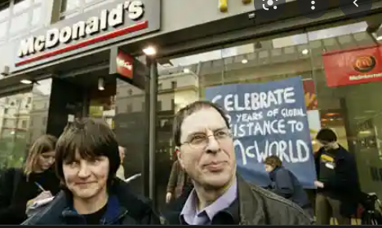
TRUTH HURTS
(McLIBEL Case)
Truth is a difficult defence in practice, even for statements that many people might regard as accepted fact.
Steel & Morris v UK
  Two individuals made a series of allegations about McDonalds in a Greenpeace pamphlet. Both sued for libel and malicious falsehood, but failed to justify/prove Truth of majority of the allegations.
  The allegations were statements that most people would agree with:
      McDonalds was a polluter
      McDonalds food was unhealthy
HOWEVER
  They could not prove it.
Notes:
39
39
Damages of £60,000 (reduced to £40k on appeal) including injunction and costs.
The trial lasted 198 days.

Slide 40
QUALIFIED PRIVILEGE
Qualified Privilege (mutual duties/interest) protects:
  Answers to inquiries as to character, financial position and responsibility
  Employment references
  Publications necessary by statute or contract
  Publications within clubs or associations of common interest
  Reply to attack
  Balanced activism and campaigning materials
  Raising grievances to the appropriate responsible regulator (as opposed to the public via the media—see Suresh v Samad [2017] EWHC 76 and Pinard –Byrne v Linton [2015] UKPC 41)
QP will protect criticism if it is activist or campaigning and balanced

Slide 41
STATUTORY QUALIFIED PRIVILEGE
  Covers fair and accurate reports of statements from Official Sources
  Courts & tribunals in UK & internationally
  Public documents, documents issued by governments, Police statements
  Public proceedings of Parliaments (worldwide)
  Public statements issued by a legislature of government (worldwide)
  Reports of and public statements issued/published by an International Organisation or conference
  Reports of Public Inquiries –investigations
  Reports of proceedings at a press conference anywhere in the world for the discussion of a matter of public interest
  Company meetings –AGM etc.
      http://www.legislation.gov.uk/ukpga/1996/31/schedule/1
      http://www.legislation.gov.uk/ukpga/2013/26/section/7/enacted
MUST QUOTE to have Statutory Privilege – linking is not enough
Notes:
41
41
41

Slide 42

HONEST OPINION (FAIR COMMENT)
Comment can reasonably be inferred to be a deduction, inference, conclusion, criticism, remark, observation, etc.
See Branson v Bower [2001] EWCA Civ 791. Art 10 issues arise if courts require proof of opinions, Lingens.
  Statement of opinion –a value judgement v fact
  Must be based on true or privileged facts
  Indicates its factual basis in general or specific terms
Does not have to be reasonable.
  E.g. Restaurant reviews— simply must that one has ordered a dish and any opinion about it is protected even if harsh/extreme.
  Same for Glassdoor reviews
Bald statements without supporting facts may be interpreted as comment rather than fact.
Hard to distinguish.
This will protect
criticism
Notes:
42
42
42

Slide 43

OPINION
Through its distinction between facts and value judgements, the ECHR Court has pointed out that opinions are less “susceptible of proof,” and must therefore be protected more robustly than false assertions of fact (Lingens vs Austria, 1986).
False or wrong speech is also protected
Notes:
43
43

Slide 44
UPSHOT
Panels should be slow to find disparagement, tarnishing or dilution from criticism
If there is a defence to defamation, there is no tort and no libel and no unlawful conduct and likely legitimate speech
Notes:
44
44

